Slide 1
Firearms Dealer Inspection
Integrated Training

Slide 2
Integrated Partnership
Bureau of Alcohol, Tobacco, and Firearms (ATF)
Executive Office of Public Safety & Security (EOPPS)
Massachusetts State Police (MSP)
Department of Criminal Justice Information Systems (DCJIS)
Firearms Records Bureau (FRB)
Municipal Police Training Committee (MPTC)

Slide 3
Agenda
Legal Authority
Shop Requirements
Record Keeping
Transfer/Sales Requirements
Assault Weapons
MA Inspection Steps, Techniques, & Outcomes
ATF Inspections
Proper annual inspections of gun shops prevent unlawful sales of firearms and keep illegal firearms off the streets.

Slide 4
Licensing Authority Inspection Responsibility
MGL c. 140, § 123:
The licensing authority shall enter, one time per calendar year, during regular business hours, the commercial premises owned or leased by any licensee, wherein such records required to be maintained under this section are stored or maintained, and inspect, in a reasonable manner, such records and inventory for the purpose of enforcing the provisions of this section.

Slide 5
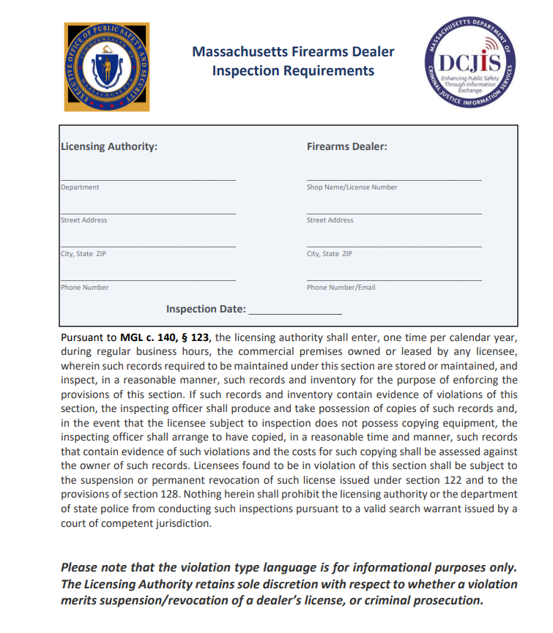
Checklist
A checklist has been created to assist municipalities in conducting the inspections mandated by MGL c. 140, § 123.
The checklist and attestation are available on the DCJIS Extranet:
http://170.154.255.103/default.aspx

Slide 6
Common State Violations
Violation Types
Gun Shop License Suspension
Felony
Misdemeanor or Felony (Safe Storage Statute)
Common Violations
Straw Purchases
Poor Record Keeping (non-reporting of transactions in MIRCS)
Firearm Roster Violations
Sale of Assault Weapons

Slide 7
DCJIS- Firearms Records Bureau (FRB)
Review license in MIRCS
Repository for firearms and transaction records
Maintain MIRCS applications
Business location
Criminal background check
Print dealer licenses.
Licensing officer issues license.
Dealer contacts FRB for training and MIRCS account. Training online in person at the business location.
Onboard Dealers
Letter sent to new dealer and licensing officer > training/annual inspection requirement.

Slide 8
Shop Inspection Requirements
Requirement 1
The dealer’s license and certificate are displayed on the premises.
Requirement 2
No firearm is displayed in an outer window or anywhere it can easily be seen from outside.
Requirement 3
Warning to the right ( >) must be posted at the counter and be distributed with each transaction.
IT IS UNLAWFUL TO STORE OR KEEP A FIREARM, RIFLE, SHOTGUN, OR MACHINE GUN IN ANY PLACE UNLESS THAT WEAPON IS EQUIPPED WITH A TAMPER-RESISTANT SAFETY DEVICE OR IS STORED OR KEPT IN A SECURELY LOCKED CONTAINER.

Slide 9
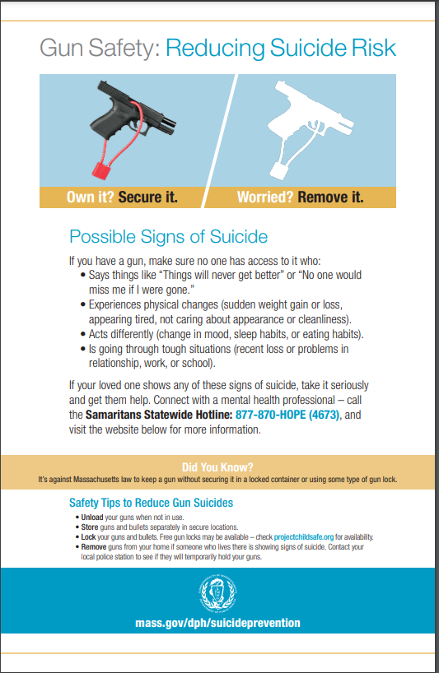
Shop Inspection Requirements, cont’d
Requirement 4
suicide prevention information developed by DPH must be posted and distributed with each transaction (online)

Slide 10
Shop Inspection Requirements
Requirement 5
The shop is a permanent place of business on a commercial premise and is not a residence or dwelling.
Examples of non-compliance:
The gun shop is in a shed on the gun dealer’s residence;
The shop does not have an official address designated by the town;
The gun shop’s building also has residential units.

Slide 11
Shop Inspection Requirements
Requirement 6:
Massachusetts firearms dealers are required to perform criminal offender record information (CORI) checks prior to hiring any person who has “direct and unmonitored” contact with firearms to determine the suitability of the employee.
Notes:
IMPORTANT: the FRB ensures that new dealers register for CORI accounts and that CORI checks are completed for current employees prior to account creation and training. FRB does not follow-up on employees hired after the shop opens. FRB requires dealers with no employees to sign a “sole employee exemption” form. If needed, DCJIS could provide a list of background checks performed via iCORI by the gun dealer or a copy of the exemption form.

Slide 12
Shop Inspection Requirements
Important Notes on Requirement 6
The FRB ensures new dealers register for CORI accounts
current checks are completed on current employees before account creation and training.
FRB does not follow up for those hired after opening
Dealers with no employees sign a “sole employee exemption” form
DCJIS could provide a list of background checks performed via iCORI

Slide 13
Shop Inspection Requirements
Requirement 7:
All firearms are stored and secured properly “in a locked container or equipped with a tamper-resistant mechanical lock or other safety device, properly engaged so as to render such weapon inoperable by any person other than the owner or other lawfully authorized user.”
Under MA law, dealers are not permitted to keep inventory off premises.

Slide 14
Record Keeping Requirements
Recommended that the licensing authority contact the FRB 2 weeks before the inspection
Request a spreadsheet of the dealer’s firearms transactions be entered into MIRCS Dealer Application for the previous year.
This data can be used to:
verify that sales have been transmitted properly by spot-checking against signed FA10 forms
help determine if any non-compliant firearms have been transferred.
FRB Contact info: 617.660.4782 or FRB@mass.gov

Slide 15
Record Keeping Requirements
Requirement 1:
All transactions must be transmitted electronically via the MIRCS Dealer Application at the time of the transaction.
Requirement 2:
Dealer maintains a signed copy of the printed FA10 form.
Best Practice: for Requirements 1 and 2:
Use the data from the FRB to match up against the paper FA10 forms.
If a signed form exists, but there is no electronic transaction, then the dealer did not fully transmit the transaction.
You can also request to see the dealer’s “drafts” in the MIRCS Dealer Application. The printed FA10 forms should also be matched against federal 4473 forms.

Slide 16
Record Keeping Requirements
Requirement 3:
All sales are made to appropriately licensed individuals.
Requirement 4:
All records are kept on the premises.
Requirement 5:
Lost or stolen firearms must be reported electronically to DCJIS.

Slide 17
Transfer/Sales Requirements
Requirement 1:
Firearms are unloaded when delivered to the purchaser.
Requirement 2:
All transactions are completed on premises.
Requirement 3:
Dealers may not transfer assault weapons and large capacity feeding devices not otherwise lawfully possessed on September 13, 1994.
*Exception – Law Enforcement Officers.

Slide 18
Transfer/Sales Requirements
Requirement 4 :
All handguns transferred meet the conditions of the Approved Firearms Roster Regulations (501 CMR 7.00) and the Attorney General’s Consumer Protection Regulations. The most current rosters are available online
Requirement 5:
All sales require the in-person presentment of a current firearms license.
Requirement 6:
State-approved trigger locks must be provided with each firearm sold.

Slide 19
“Assault Weapon” Definition
“Assault weapon” is a semiautomatic weapon as defined in Federal Public Safety Act, 18 USC section 921(a)(30) from September 13, 1994. A weapon that predates this is not an "Assault Weapon“ and is transferable.
Consult 18 USC section 921 (a)(30) for the entire enumerated weapons list. List consists rifles, shotguns, and pistols.
Avtomat Kalashnikov (AK) (all models);
Action Arms Israeli Military Industries UZI and Galil;
Colt AR-15;
Fabrique National FN/FAL, FN/LAR and FNC;
Steyr AUG;
INTRATEC TEC-9, TEC-DC9 and TEC-22; and
Revolving cylinder shotguns, such as, or similar to, the Street Sweeper and Striker 12
In 1998 Mass legislature voted to keep its own AWB permanently, anticipating the 2004 expiration of the Federal ban.

Slide 20
All models of AK rifles (47, 74, etc.), copies or duplicates of any caliber are prohibited.

Slide 21
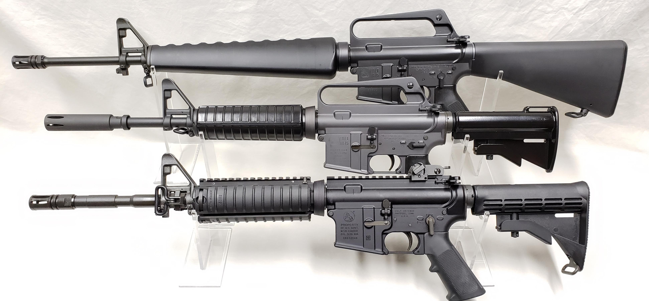
Colt AR-15, copies, or duplicates of any caliber are prohibited (LEOs are permitted to purchase)

Slide 22
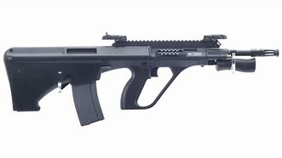
Steyr AUG or copies or duplicates of these weapons (any caliber) are prohibited.

Slide 23
Revolving cylinder shotguns such as, or similar to, the Streetsweeper 12 Gauge are prohibited (copies or duplicates in any gauge or caliber)

Slide 24
Also, a weapon was deemed to be an Assault weapon if it was found to possess a combination of key features outlined in 18 U.S.C. Chapter 121 AW Feature test:
(1) AW Feature test (for rifle)
A semiautomatic rifle manufactured after Sept 13, 1994 that has an ability to accept a detachable magazine AND has at least of two (2) of the following five (5) features is prohibited:

Slide 25
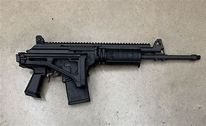
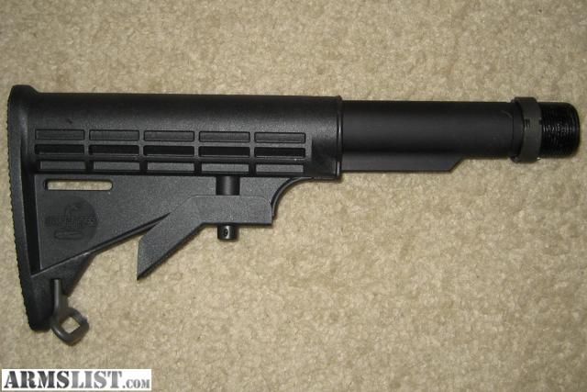
A folding stock or Telescoping stock;
Folding stock shown in folded configuration
Telescoping stock depicted open and not attached to receiver

Slide 26
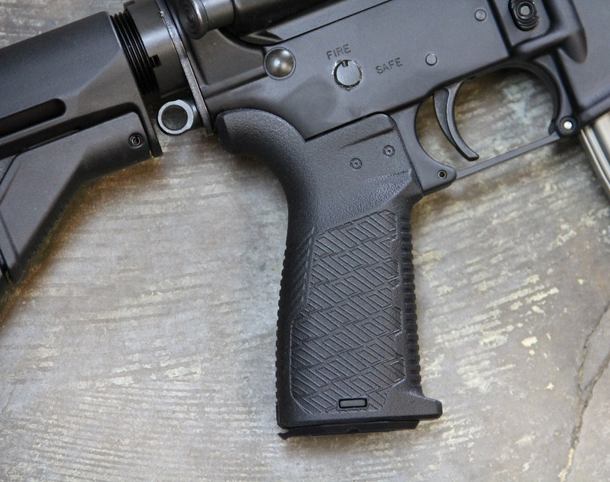
A pistol grip that protrudes conspicuously beneath the action of the weapon

Slide 27
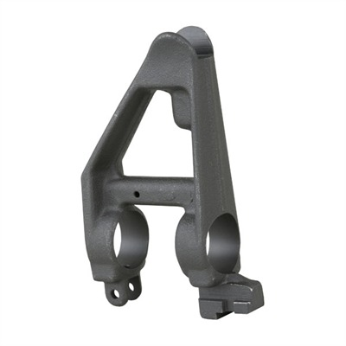
A bayonet mount
A stud or lug is designed to accept and lock in a bayonet or fixed-blade knife.

Slide 28
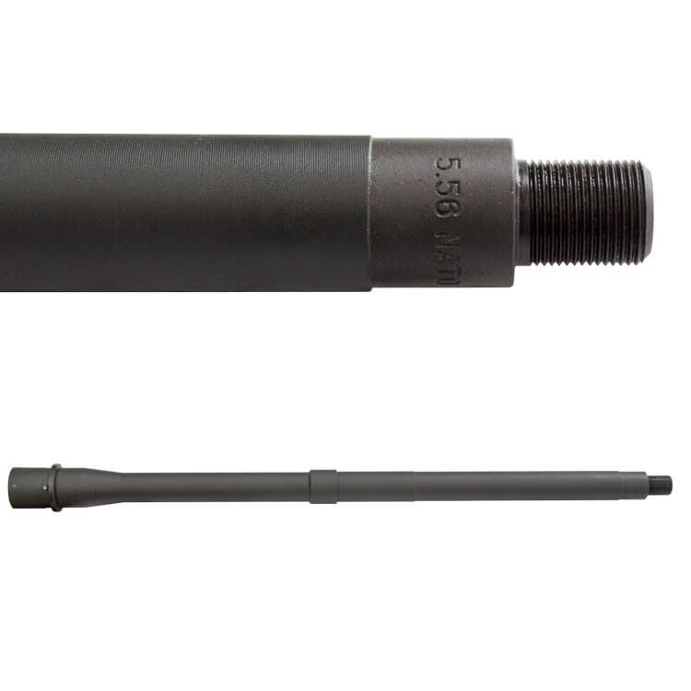
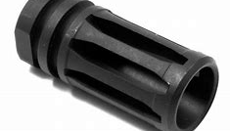
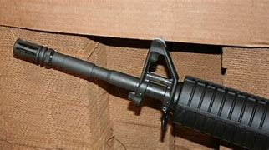
A flash suppressor or threaded barrel designed to accommodate a flash suppressor.

Slide 29
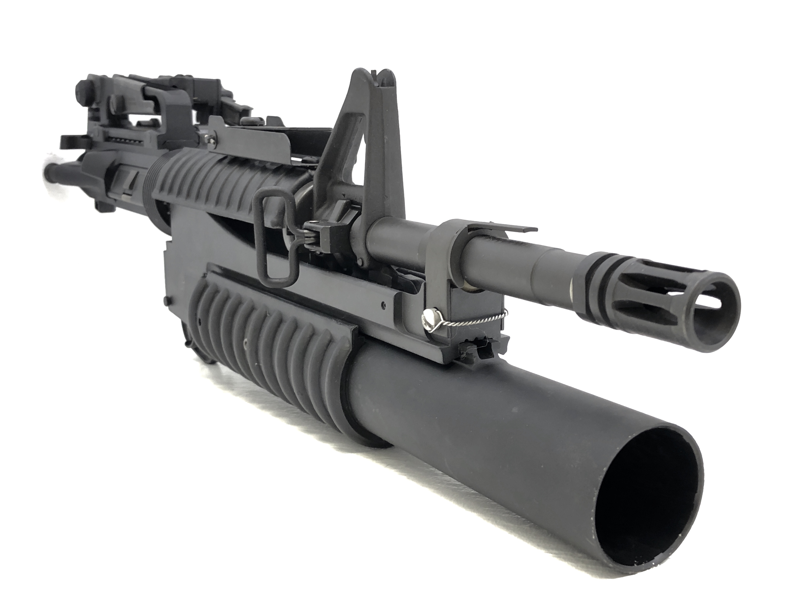
Grenade launcher

Slide 30
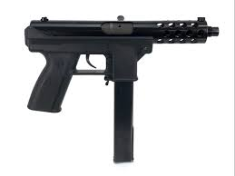
Feature test
A semi-automatic shotgun manufactured after Sept. 13, 1994 that has at least two (2) of the following features:
a folding/telescoping stock;
a pistol grip that protrudes beneath the action;
holds more than five (5) rounds of ammunition in a fixed tube/magazine; or
ability to accept a detachable magazine.
A semi-automatic pistol manufactured after Sept. 13, 1994 with detachable magazine and two (2) or more of the following:
Magazine that attached outside the pistol grip
Threaded barrel to attach barrel extender, flash suppressor, handgrip, or suppressor
Barrel shroud that prevents burn to operator
Unloaded weight of 50 ounces or more

Slide 31
MA Attorney General Guidance
2016: the A.G. issued an Enforcement Notice to gun sellers defining “Assault Weapon” contained in G.L. 140 s. 121.
Guidance applied to future transfers or sales of “Assault Weapons” as defined in Section 121
The sale, transfer, or possession of an "Assault Weapon" is unlawful (MGL 140 s 128 & 131M)

Slide 32
Copies & Duplicates
On July 20, 2016 MA Attorney General’s office declared an enforcement notice.
Reiterating that the so called “Mass compliant rifles” sold in MA since the 1994 AWB were in effect copycats. They were copies and duplicates of “Assault weapons”, and as such violations of the MA AWB.
As such Dealers were prohibited from transferring new weapons from that day forward. Provisions were made for weapons already possessed prior to that date.
“the Guidance will not be applied to future possession, ownership or transfer of AW by dealers, provided that the has written evidence the weapons were transferred to the dealer in the COMM prior to July 20,2016.”
Private transfers are allowed,
“ Application of this Enforcement Notice (Individual gun owners): The Guidance will not be applied to possession, ownership or transfer of an Assault weapon obtained prior to July 20, 2016.”

Slide 33
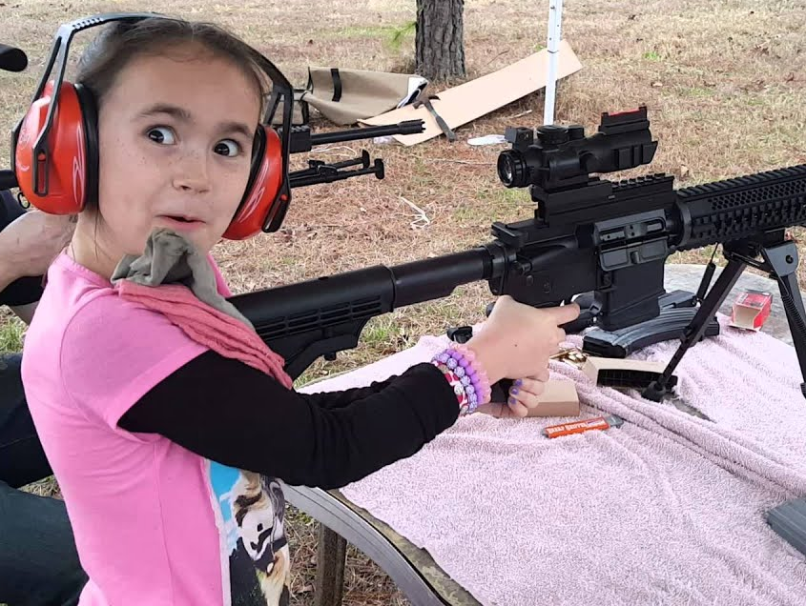
Copy or Duplicate Guidance
A copy or duplicate if meets one or both of the following:
a semiautomatic rifle or handgun that was manufactured or subsequently configured with an ability to accept a detachable magazine
AND/OR
a semiautomatic shotgun that has at least two of the following features
a folding/telescoping stock;
a pistol grip that protrudes beneath the action;
holds more than five (5) rounds of ammunition in a fixed tube/magazine; or
ability to accept a detachable magazine.

Slide 34
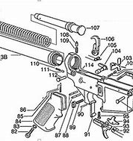
(2) Similarity Test
A copy or duplicate if:
its internal functional components are substantially similar in construction and configuration to those of an enumerated weapon (e.g., AR pattern, AK Pattern rifles).
Seek qualified assistance in determining the internal configuration of a suspected “Assault Weapon.”

Slide 35
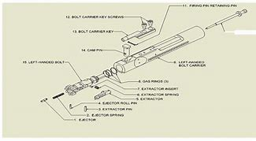
(3) Interchangeability Test
A copy or duplicate if it has a receiver that is the same as, or interchangeable with that of an enumerated weapon
includes or accepts two (2) or more operating components with those of an Enumerated weapon that are the same or are interchangeable
Components could include, but are not limited to:
trigger assembly;
bolt carrier or bolt carrier group;
charging handle;
extractor or extractor assembly;
magazine port.

Slide 36
Copies & Duplicates
under one or both of the applicable tests remains a prohibited weapon even if altered by the seller.
treated as an “Assault Weapon” even if seller alters it by doing the following:
Pinning the stock to an unfolded or open fixed position.
Removing a pistol grip
Removing a bayonet mount
Removing a flash suppressor
Preventing the weapon from accepting a detachable magazine
Reminder: Seek qualified assistance in determining the internal configuration of a suspected "Assault Weapon".

Slide 37
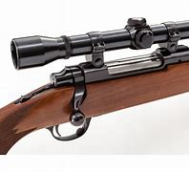
Not Assault Weapons
Any of the weapons, or replicas or duplicates of such weapons, specified in appendix A to 18 USC section 922 as appearing in such appendix on September 13, 1994. Such as weapons that were manufactured on October 1, 1993.
Any weapon that is operated by manual bolt, pump, lever, or slide action.

Slide 38
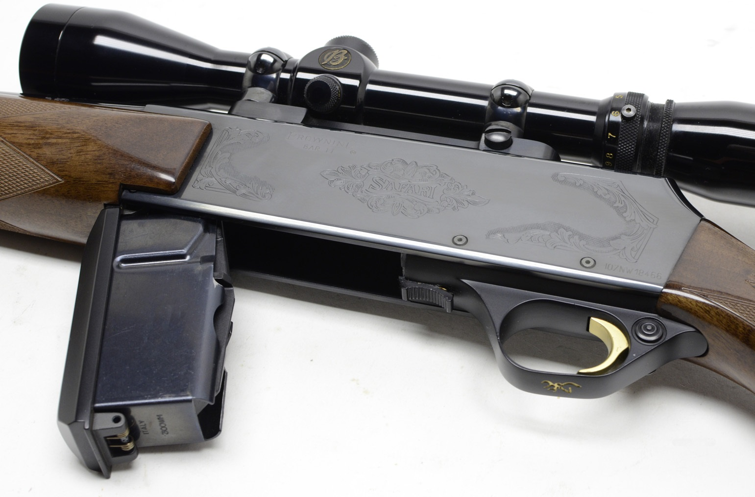
Not Assault Weapons
Any weapon manufactured prior to 1899. Simply will not meet the legal definition of firearm, rifle, or shotgun under MGL 140 s. 121
Any semiautomatic rifle that cannot accept a detachable box magazine that holds more than five (5) live cartridges; or
Any semiautomatic shotgun that cannot hold more than five (5) shotshells in a fixed or detachable magazine.

Slide 39
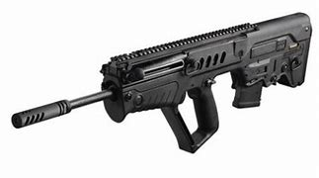
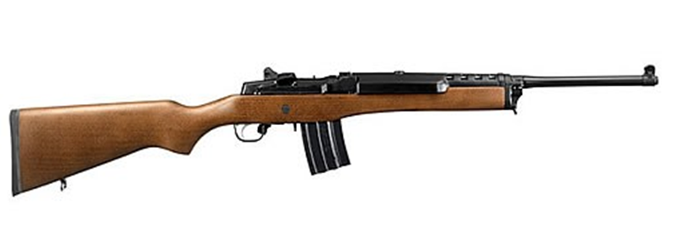
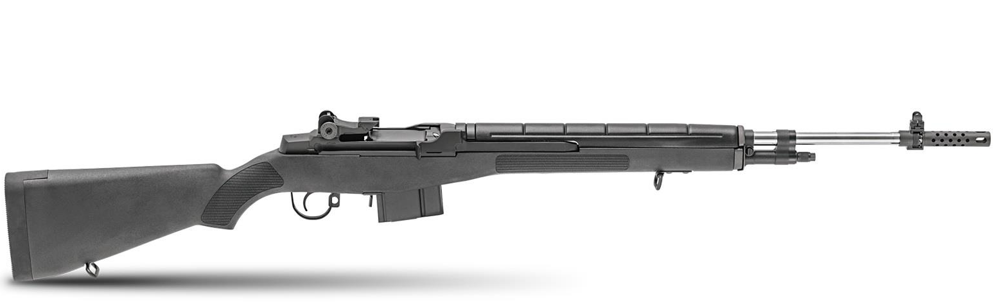
Not Copies or Duplicates (Allowed)
Ruger Mini 14 or similar model
IWI Tavor, or a substantially similar model
M1A1 or a substantially similar model

Slide 40
Inform ATF…
Any attempt to deny you entry to conduct your inspection
If required records are not being stored at the business premises
Information related to possible violations of Federal law pertaining to NICS, not executing Forms 4473, missing firearms, and prohibited transfers
Evidence the FFL is conducting business away from his licensed premises (not associated with a gun show in MA)

Slide 41
Inform ATF…
Evidence of straw sales or transfers to prohibited people
Any unusual purchasing patterns identified
Indications the FFL changed his business hours or is moving
Questions related to electronic recordkeeping systems the FFL uses
Any guidance needed or questions you may have regarding federal firearms law

Slide 42
Contact ATF for assistance
Boston Area Office
(Suffolk, Middlesex, and Essex Counties)
Area Supervisor Jon Baum 617-557-1202
Worcester Area Office
(Worcester County)
Area Supervisor Hank Hennessy 508-926-6855
Hartford Area Office
(all other counties)
Area Supervisor Sue Furtado 860-293-2540

Slide 43
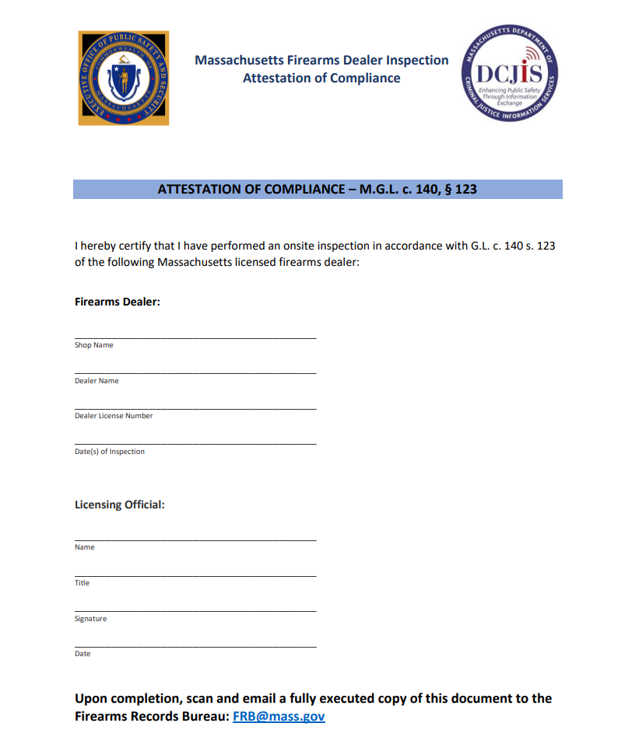
Post Inspection Communications
Violations:
Provide notice of violations to the Gun Shop owner with a notice to re-inspect.
If major violation - consider revocation or suspension of license
Criminal Violation: Consult District Attorney
Inspection Attestation:
Provide attestation of annual inspection to the FRB
Email signed and dated form on inspection checklist

Slide 44
Denying a Dealer’s License
According to MGL c. 140, s. 122: Any person refused a license under this section may within ten days thereafter apply to the colonel of state police for such license, who may direct that said licensing authorities grant said license, if, after a hearing, he is satisfied there were no reasonable grounds for the refusal to grant such license and that the applicant was not barred by the provisions of law from holding such a license.

Slide 45
Denying a Dealer’s License
Disqualifiers are:
Alien
Minor
person who has been adjudicated a youthful offender, as defined in section fifty-two of chapter one hundred and nineteen, including those who have not received an adult sentence
Convicted of a felony or of the unlawful use, possession or sale of narcotic or harmful drugs

Slide 46
Suspending a Dealer’s License
According to MGL c. 140, s. 125:
The officials authorized to issue a license under section one hundred and twenty-two, after due notice to the licensee and reasonable opportunity for him to be heard, may declare his license forfeited, or may suspend his license for such period of time as they may deem proper, upon satisfactory proof that he has violated or permitted a violation of any condition thereof or has violated any provision of this chapter, or has been convicted of a felony. The pendency of proceedings before a court shall not suspend or interfere with the power to declare a forfeiture. If the license is declared forfeited, the licensee shall be disqualified to receive a license for one year after the expiration of the term of the license so forfeited. The commissioner of the department of criminal justice information services shall be notified in writing of any forfeiture under this section.

Slide 47
Available Resources - MA
Department of Criminal Justice Information Services (DCJIS), Firearms Records Bureau (FRB).
Firearms Transaction Records
Contact: FRB Contact info: 617.660.4782 or FRB@mass.gov
Gun Control Advisory Board (GCAB)
Firearms Roster: https://www.mass.gov/lists/approved-firearms-rosters

Slide 48
Available Resources - MA
MSP Crime Lab - Firearms Identification Section
Monday – Friday 7AM – 5PM contact your Regional Office
FIS Central in Maynard (HQ) 978-451-3480
FIS West in Springfield 413-205-1840
FIS South in Lakeville 508-946-1210
FIS North in Danvers 978-538-6062
if needed after hours contact your respective Troop HQ and ask to speak with the Duty Lieutenant, who will make notification

Slide 49
ATF Legal Authority
Authority to conduct inspections once every 12 months under Federal law 18 U.S.C. 923(g)(1) & 27 CFR 478.23
Unannounced (typically)
Why Are Compliance Inspections Conducted?
gauge compliance and rectify unlawful behavior,
educate industry members to promote voluntary future compliance
protect the public

Slide 50
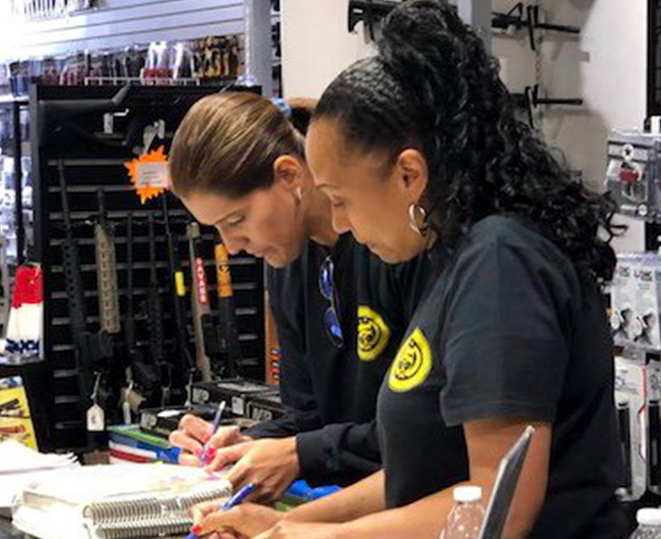
Basic Steps involved in ATF inspection
100% inventory and reconciliation of any discrepancies
Firearm to Acquisition and Disposition (A&D) Record; A&D record to inventory
Ensure loss report is prepared and submitted as applicable
Review A&D record for complete info, timely entries, and lawful transfers

Slide 51
Basic Steps involved in ATF inspection
Review Forms 4473 executed over the prior 12 months (unless expanded based on circumstances):
Verify that NICS checks are being done, and information is recorded on each form
Ensuring IDs are being checked and recorded
Transfers to prohibited people have not occurred
Age requirements met
Ensure Multiple Sales Reports are completed and submitted
Ensure transfers to other FFLs, and law enforcement for official purposes are conducted lawfully
Cross-check required records to commercial records and state records (if provided by the licensee) for accuracy

Slide 52
Basic Steps involved in ATF inspection
Identify any suspicious purchasers, straw purchases, prohibited transfers, and other possible unlawful activity
Refer this information to the appropriate ATF group or external partner (including local MA Police)
Resolve any unsuccessful or open/pending traces
After all steps completed, hold a closing conference with the licensee
Review violations found
Ensure corrective action has been taken
Educate licensee on federal requirements and obtain a signed Acknowledgement of Federal Firearms Regulations
Make recommendations to enhance the licensee’s internal controls to increase the likelihood of future compliance

Slide 53
Most Common Violations
Nationwide Top 3
Failure to complete forms as required
Failure to maintain accurate acquisition and disposition (A&D) records
Failure to complete ATF Form 4473 as required
Boston Field Division Top 3
Failure to sign and date Form 4473
Failure to maintain accurate acquisition and disposition (A&D) records
inclusive of all license types- includes unrecorded firearms, those not logged out in the time required and/or missing)
Failure to complete forms as required

Slide 54
Inspection Outcomes
Report of Violations (ROV) issued
Depending on the nature and the number of violations, ATF may also:
Issue a warning letter to the licensee
ATF Area Supervisor or Director of Industry Operations holds a warning conference with the licensee
Pursue revocation proceedings
Outcome of the inspection may warrant a recall inspection if a revocation is not the final outcome.

Slide 55
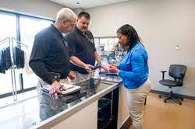
ATF Field Techniques
Build rapport and ask open-ended questions
Set firm dates for corrective action
Completing basic recordkeeping requirements:
Is the FFL executing Forms 4473? (limited exceptions to this requirement)
Is the FFL checking IDs before transfer?
Is the FFL running background checks?

Slide 56
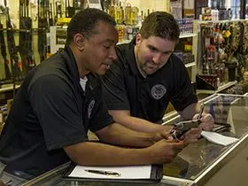
ATF Field Techniques
Inventory focus
Is the FFL maintaining an A&D record?
Is there evidence that the licensee has internal controls, e.g. a tagging system on all firearms in inventory?
Typically, a licensee with inventory issues will also have issues with other recordkeeping requirements
If it is an electronic system, can the employees access it?

Slide 57
ATF Field Techniques
When conducting an inventory, compare markings on the firearm to records
Don’t rely on box labels
Always use safe handling when inventorying firearms
Are there any missing firearms?
Losses due to poor recordkeeping, evidence of theft from employees, or other means?
Thefts/losses must be reported to both ATF and the Police Department having jurisdiction in that municipality

Slide 58
MGL c 140 s. 131Q
Massachusetts General Law Chapter 140 s. 131Q requires all Massachusetts "licensing authorities" to report certain tracing data on all firearms, rifles, shotguns, large capacity weapons, machine guns or assault weapons used to carry out a criminal act to the Commonwealth’s Fusion Center.

Slide 59
MGL c 140 s. 131Q
What is a criminal act that triggers the reporting requirement?
Any criminal act involving the use of a firearm, rifle, shotgun, large capacity weapon, machine gun or assault weapon:
Improper storage
Possessing a firearm while intoxicated
Unlawful possession of a firearm

Slide 60
MGL c 140 s. 131Q
What guns should not be reported?
Firearms used in suicides
Firearms seized pursuant to a G.L. c. 209A Order UNLESS there is a criminal investigation and the firearms were seized pursuant to a G.L. c. 209A violation or other criminal act
Firearms obtained in the course of an open (undercover investigation) are not to be reported until the investigation is closed and there is no longer any potential officer/informant safety threat
Firearms obtained in a “buyback program,” unless it is subsequently determined that the firearm was used in a previous and unrelated criminal act
Ammunition, magazine and clips should not be reported

Slide 61
MGL c 140 s. 131Q
What information should be reported?
Make Model Lost/stolen
Serial number Caliber Obtained illegally
Type of crime committed Fingerprint evidence
Ballistic evidence Gang activity
Is the individual a prohibited person
Whether an arrest was made or conviction obtained*
* this can be updated following initial data entry

Slide 62
ATF eTrace
MGL c 140 s. 131Q is NOT eTrace!
i.e.- Reporting crime gun information does not assist in developing investigative leads or identifying trends and patterns.
eTrace on the other hand, provides law enforcement with vast crime gun intelligence
Massachusetts State Police recommend that departments opt-in to ATF’s eTrace Collective Data Sharing System.

Slide 63
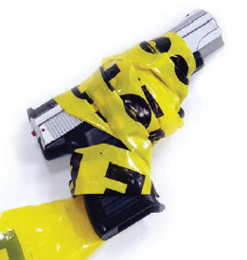
ATF eTrace
Why are firearms traced?
Link a suspect to a firearm in a criminal investigation
Identify potential traffickers
To detect in-state, interstate, and international patterns and the sources and kinds of crime guns
Assist in developing potential witnesses
Determining the sources of firearms used in crimes
Proving ownership
Producing other investigative leads
* A firearms trace is often the first step in determining how a firearm moved from lawful commerce into a crime scene or criminal act.

Slide 64
What is eTrace?
ATF’s eTrace is a paperless firearms trace submission system and interactive analysis module that facilities firearms tracing and assists ATF’s efforts to combat firearms trafficking.
The system provides real-time capabilities that allow law enforcement agencies to submit electronic firearms trace requests, monitor the progress of traces, retrieve completed trace results, and query firearms trace-related data in the Firearms Tracing System (FTS) database

Slide 65
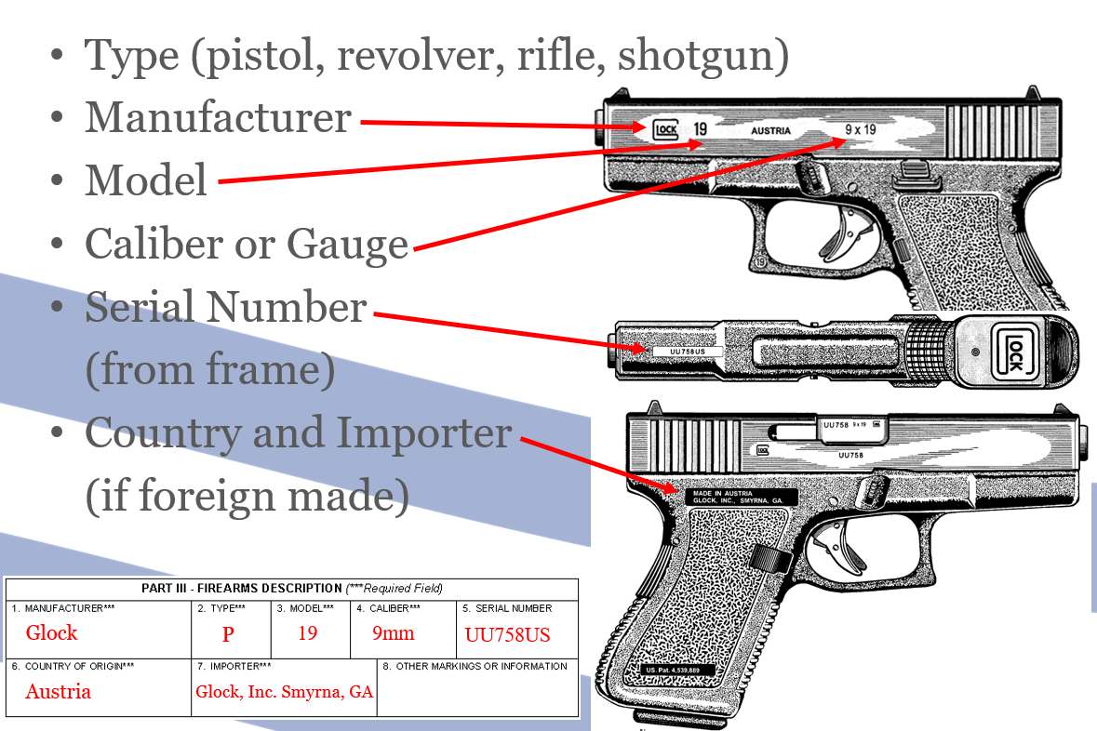
Firearm Tracing and Identification
What is a firearms trace?
A firearms trace is the systematic tracking of the movement of a firearm recovered by law enforcement officials, beginning with its importation into, or its manufacture in, the United States through the distribution chain of Federal firearms licensees to the point of its first retail sale.

Slide 66
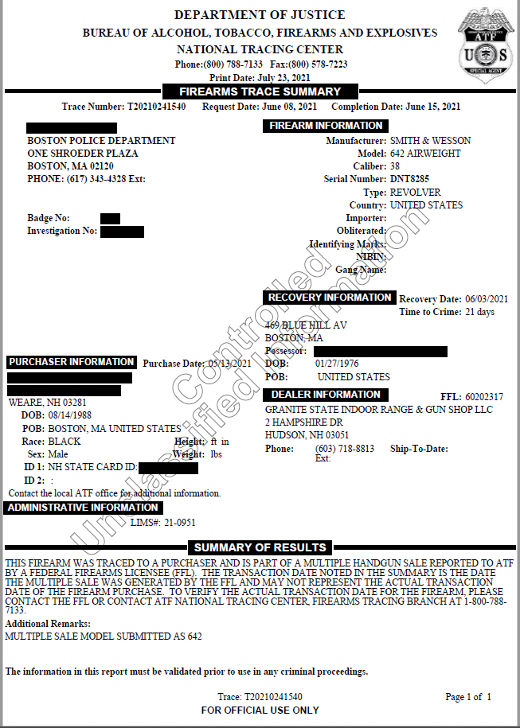
ATF Firearms Trace Summary

Slide 67
Benefits of Comprehensive & Timely Tracing
Public Safety
Interdict active firearm traffickers/straw purchasers
Stop flow of unlawfully obtained firearms into local jurisdictions
Enhance Prosecutions
Interview with purchaser can corroborate possession
Purchaser can link individual(s) to firearms used in NIBIN incidents

Slide 68
Benefits of Comprehensive & Timely Tracing
Actionable Intelligence
Preservation of evidence (ie. phone communications, cell tower, location information, toll records, social media, surveillance video)
Planned enforcement operations (ie. reverse, calls with target)
Identification of co-conspirators (ie. link to larger trafficking conspiracy or criminal organization)
Identification of FFLs (Federal Firearms Licensees) for compliance inspections

Slide 69
Benefits of Comprehensive & Timely Tracing
Identify Trends or Patterns in Jurisdiction
Source state(s)
Common FFLs/Pawn shops
Recovery locations
Expand your crime gun understanding outside your jurisdiction with Collective Data Sharing

Slide 70
Main Objective
Increase rate and frequency of tracing/reporting by state, local, & federal partners.
*Ultimate goal*
Tracing 100% of crime guns upon recovery.
How?
Establish eTrace accounts
Contact local ATF office for assistance and/or training

Slide 71
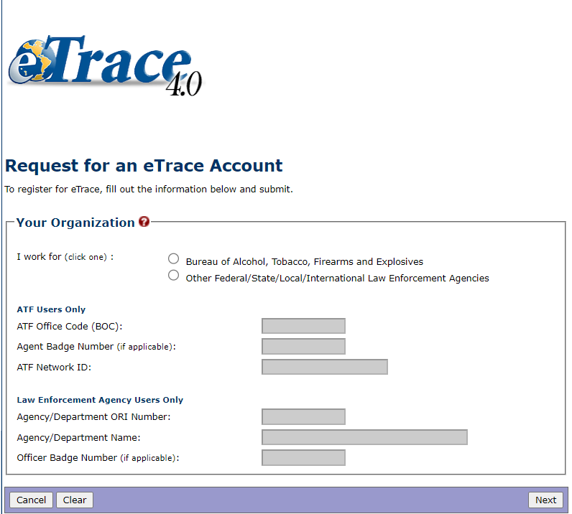
Requesting an eTrace Account
https://etrace.atf.gov/etrace/

Slide 72
Questions?

